Slide 1
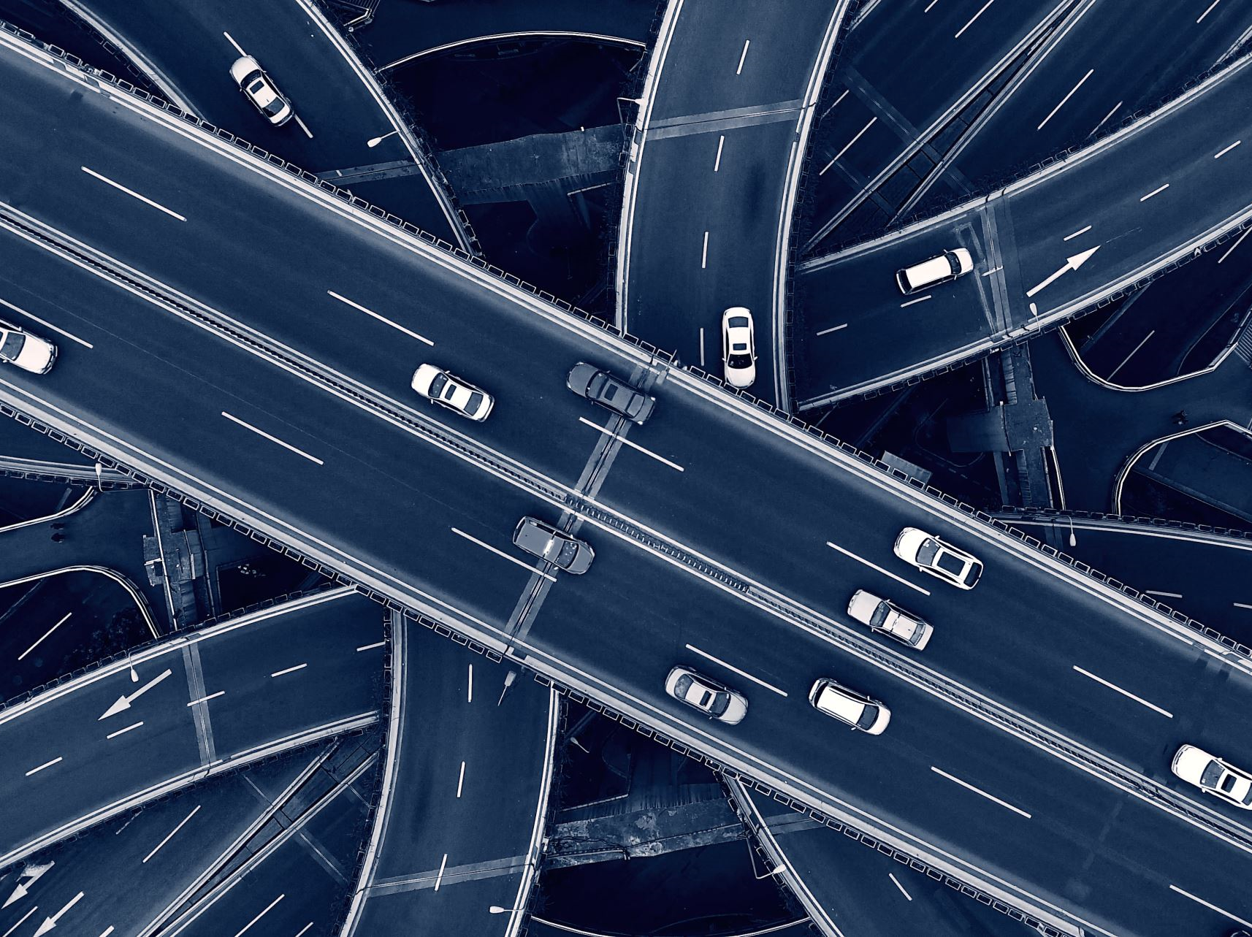

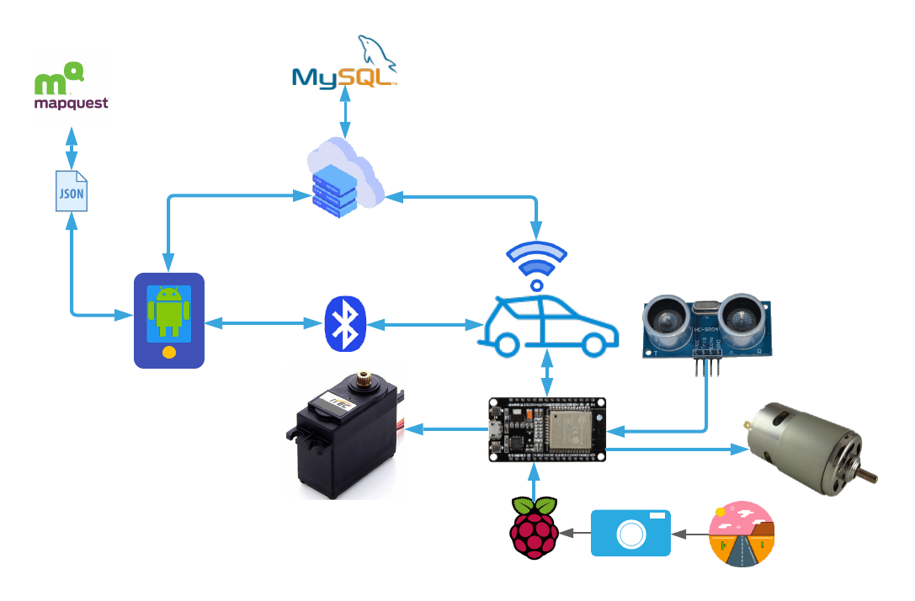
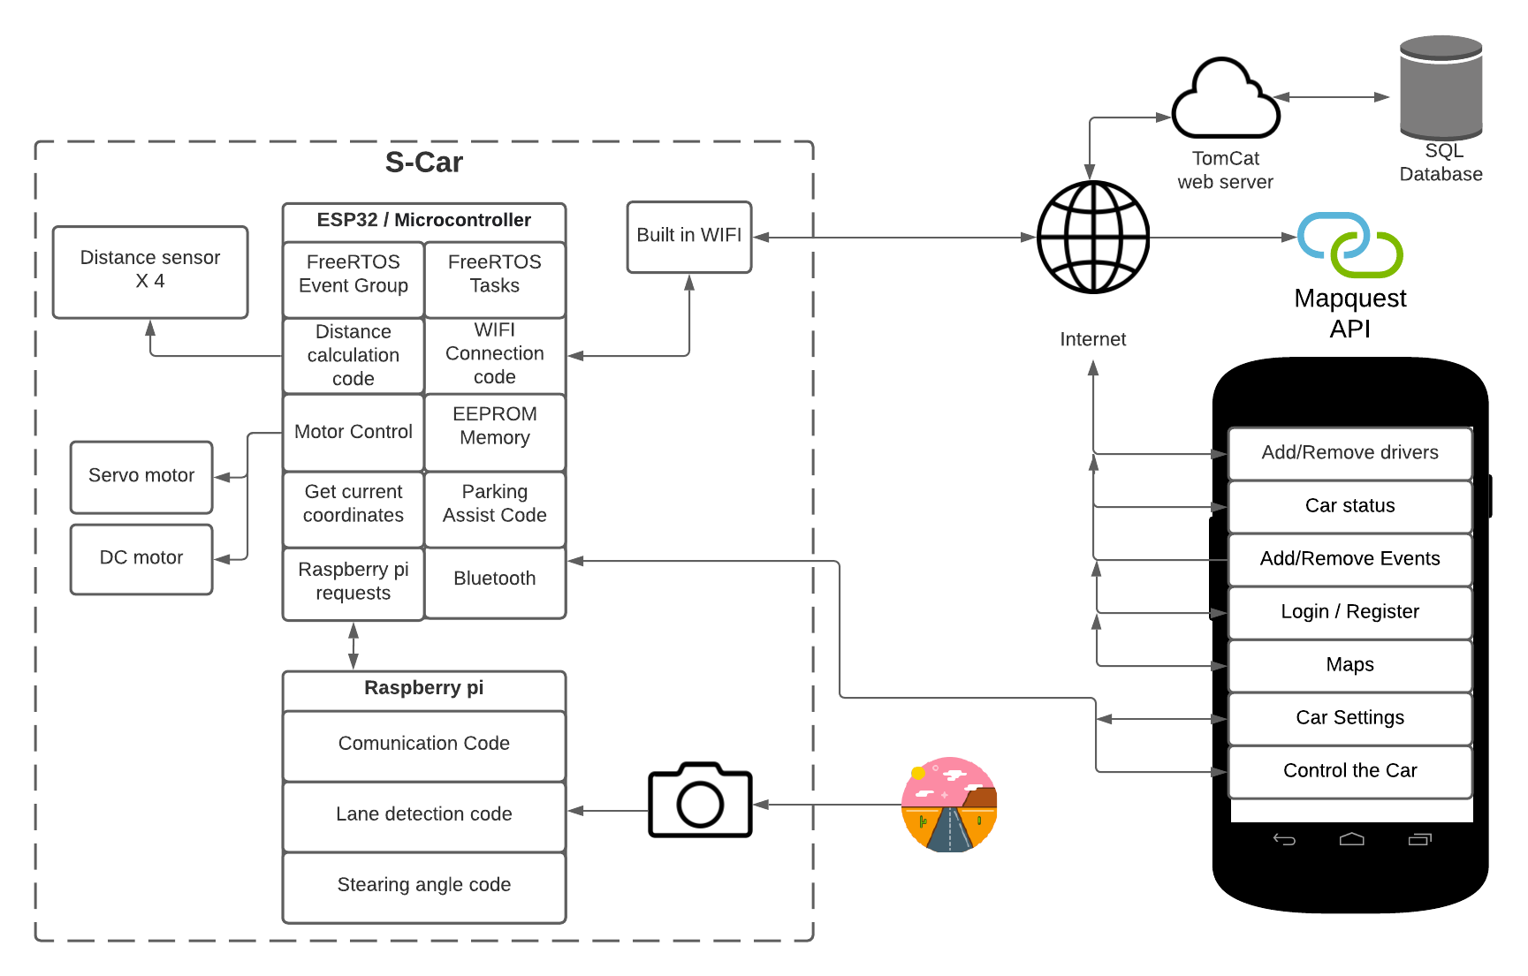


S-Car
What is S-Car
Self-Driving Car (S-Car) is a vehicle that can drive between destinations, avoid objects and take decisions without a human operator. Self-driving cars are a great improvement in the automotive world as they help us to save our environment by eliminating CO2 and use renewable energy.
Software
Android studio used to develop the app
Tomcat used to create the server in java
Map Quest API used to view the map & to get an address coordinates
SQL database to store drivers & car details
PyCharm used to write & test the lane detection code
FreeRTOS Tasks & Event group to speed up the code execution on the ESP32
OpenCV used to extract the lanes from the camera
Hardware
Ultrasonic sensors used to get the distance of the objects around the car
ESP32 used to control the car & to handle the App requests through Bluetooth
Raspberry Pi & camera used to read the road & provide ESP32 with the lanes data
DC motor used to control the car speed
Servo motor used to control the steering
RC car chassis used to put all the components together
ESC used to control the DC motor speed
Diagram
Architecture Diagram
S-Car Features
Android application
Add/Remove Drivers
Add/Remove Events
Maps
Control car through Bluetooth
Cloud storage
Advanced lane detection
Parking assist
Auto braking system
Autonomous driving
Results
S-Car fully working. It can park its self without any hard coded values, it can drive using computer vision. Android application is fully working.
Mohamed Otaki – G00346067
Michelle Lynch – Supervisor
Bachelor of Engineering (Honours) Software and Electronic Engineering

